Slide 1

Wisco Explore!
Elias Isele-Castillo Anthony Poleski Valeria Welsh

Slide 2
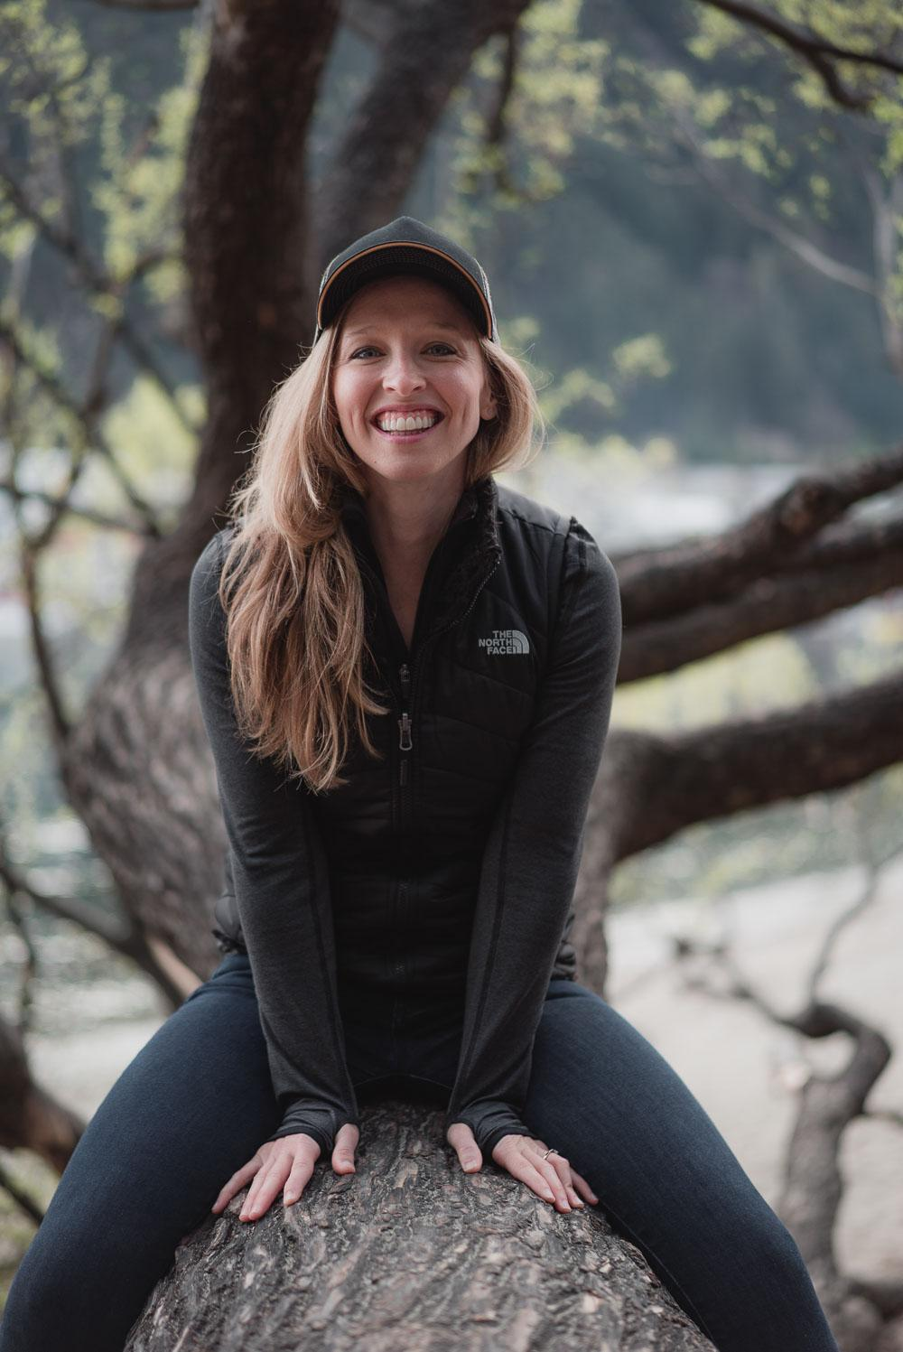
Persona
Sierra
About “I want to go to adventure, but I don’t know which one is the best option for me”
Age: 23
Location: Middleton, WI
Education: College sophomore year
Occupation: Full time student
Status: Single
Expertise level: Apprentice
Other: She has 2 golden retrievers
Key Goals:
Make a reservation online.
Detailed list of that campgrounds available activities.
Upload pictures of her experience
Motivations:
Take a break from school.
Get to know new places around her area.
Become an expert at camping.
Frustrations:
Too many ads that were also poorly placed.
Poor navigation.
Not enough information, or the information wasn’t clear enough.

Slide 3


User interviews
Overall Notes
User Goals
Find a website to book the campsite.
Choose a campsite with the desired features.
Book a campsite online.
User Problems
Poorly designed navigation.
Confusing labels.
Too much information on the websites.

Slide 4
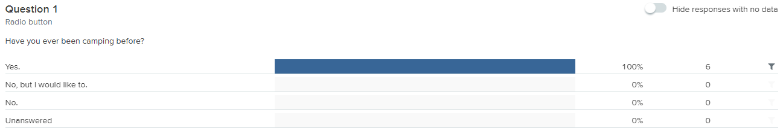
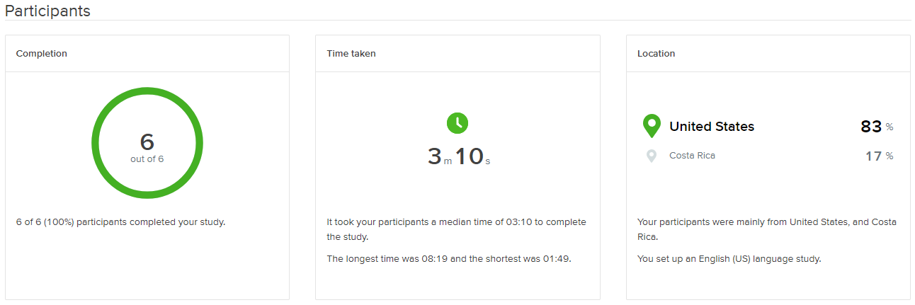
Card Sort
Pre-study question

Slide 5
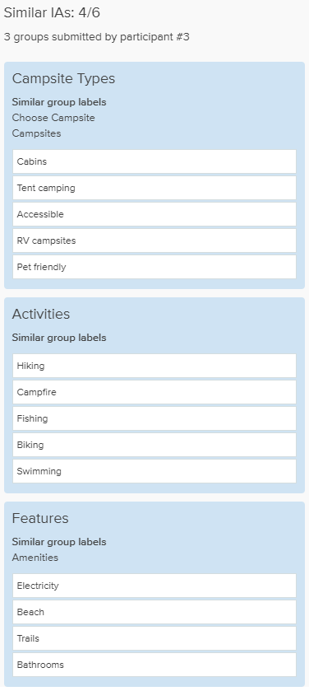

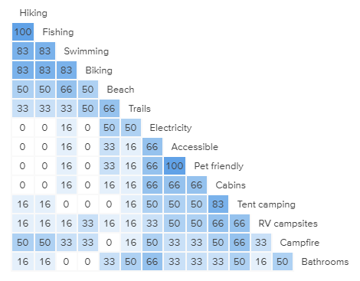









Card Sort - Results
Participant-centric analysis
Categories
Similarity matrix

Slide 6
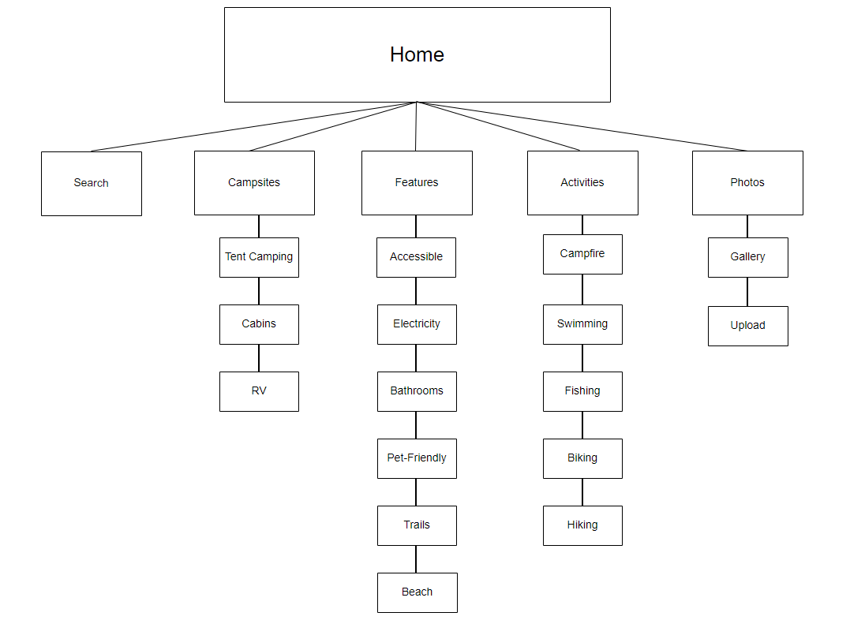
Site Map

Slide 7
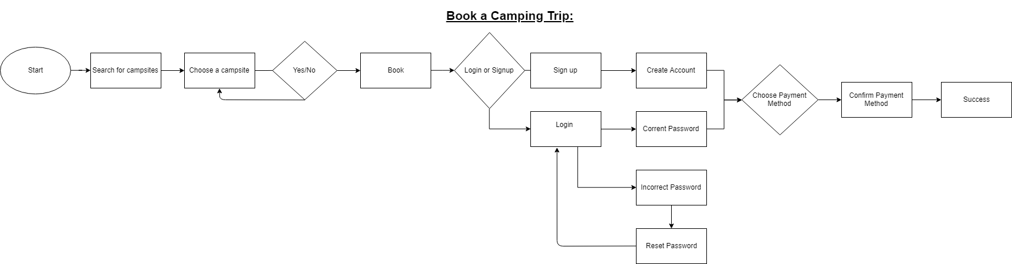
User Flow

Slide 8

Wireframe
https://app.moqups.com/onxtdkQubG/view

Slide 9
Wisco
Explore!
GREEN TEAM

